Slide 1
The County Budget: Aligning Money with Priorities and Plans
Ryan Adkison | Assistant County Administrator/Finance Director | Butler County, Kansas
205 W. Central | El Dorado, KS 67042
(P): 316.322.4300 | radkison@bucoks.com | www.bucoks.com

Slide 2
Agenda
Go over basics of budgeting for Kansas Counties
Legal framework
Budget Process
Strategic Planning

Slide 3
Why All the Laws?​
According the LKM Local Government Law Book §8.136:​
The cash basis law was one of three laws enacted by the Kansas Legislature in 1933 designed to control and regulate fiscal policies and practices of local units of government which had gotten out of hand prior to the Great Depression. The other two laws enacted in that year were the budget law, K.S.A. 79-2925 et seq., and the tax limitation law, K.S.A. 79-1945 et seq. (repealed in 1999). This package of legislation was enacted to stop local governments from borrowing money for operating purposes and shifting moneys indiscriminately from one fund to another to meet expenditures for items not originally contemplated. Further, local government financial record keeping systems were very lax to the point that it was difficult to know the true financial condition of many such units. Finally, the Legislature wanted to place overall property tax levy limitations on cities, counties, and townships.

Slide 4
Budget Law (K.S.A. 79-2925 et. seq.)​
The budget law applies to all Kansas Municipalities.​
The annual budget provides the municipality with expenditure authority and authority to levy taxes to finance those expenditures.​
All money that belongs to the municipality must be included in the annual budget.​
A separate itemized financial statement is required for each fund.​
A balanced budget must be presented for each fund, which includes all funds with a tax levy at a minimum.​
Miscellaneous category of expenditures or revenues is not to exceed ten percent.​
Budgeted transfers from one fund to another fund must be authorized by statute.​

Slide 5
Budget Law (K.S.A. 79-2925 et. seq.)​
Not all funds require a budget for the Proposed Budget Year but a fund page must still be prepared.​
The governing body must give notice (10 days before hearing) and conduct at least one public hearing for the purpose of answering questions of taxpayers about the proposed budget.​
Not exceed adopted expenditure authority, by fund, without approval from County Commissioners and through a formal amendment process​
The budget document should be certified to the County Clerk by August 25 (or Oct. 1 when exceeding RNR). County Clerk must attest to all budgets.​
Adopt the annual budget no later than 10 days prior to August 25, unless RNR was exceeded. ​

Slide 6
Budget Law – Revenue Neutral Rate
In March 2021, the Kansas Legislature passed KSA 79-2988 (formerly Senate Bill 13) to establish limitations on ad valorem property tax levies by taxing subdivisions.​
See LKM Infographic https://cdn.ymaws.com/www.lkm.org/resource/resmgr/files/infographics/SB_13_Infographic_v3.pdf

Slide 7
RNR Info

Slide 8
RNR Info
What is the Process to Exceed the RNR (setting a mill levy higher than the RNR)?
Notify the County Clerk by July 20 with intent to exceed the revenue neutral rate.
Place a notice on the city website and in a newspaper of general circulation in the
county 10 days prior to the hearing.
No earlier than August 20 and no later than September 20, conduct a tax rate and
budget hearing giving taxpayers an opportunity to comment on the budget.
Adopt a resolution or ordinance to exceed the revenue neutral rate.
Adopt the proposed budget.
By October 1, certify to the County Clerk the amount of ad valorem tax to be levied by the taxing enity.

Slide 9
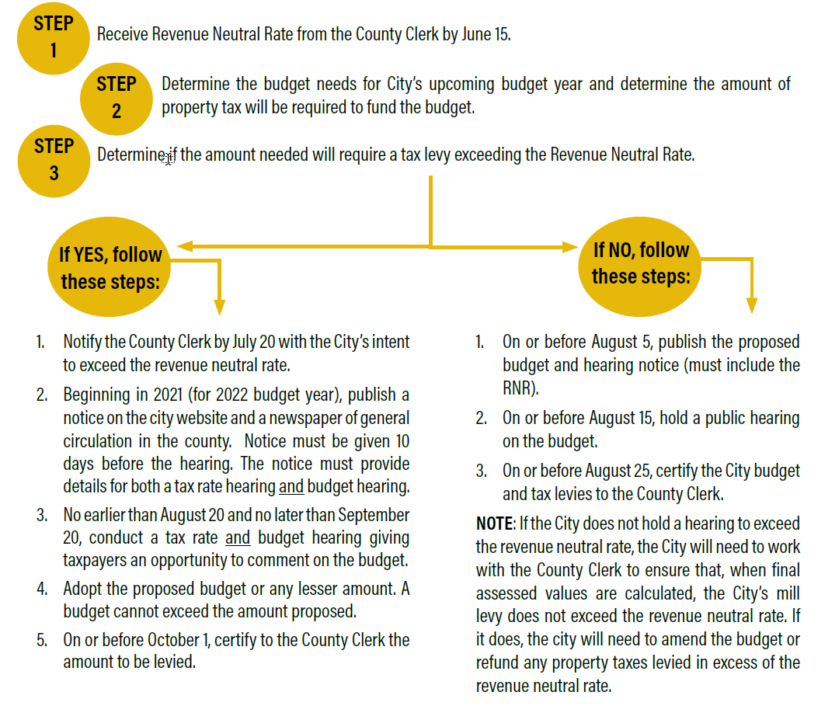

Slide 10
Capital Improvement (K.S.A. 19-120)​
The board of county commissioners of any county, which has formally approved a multi-year capital improvement plan setting forth the public improvement and infrastructure needs of the county on a prioritized basis, may establish, by adoption of a resolution, a capital improvements fund. The resolution establishing such fund, and any amendments thereto, may provide for the budgeted transfer of monies from other county funds lawfully available for improvement purposes to the capital improvements fund, including monies in the county's federal general revenue sharing fund and general fund. Any general property tax specifically levied for the use of such fund shall be authorized by resolution adopted under the provisions of K.S.A. 19-101a, and amendments thereto.

Slide 11
Capital Improvement (K.S.A. 19-120)
Monies in such capital improvements fund may be used to finance, in whole or in part, any public improvement need set forth in the adopted capital improvement plan, including the repair, restoration and rehabilitation of existing public facilities. The resolution may provide that disbursements from such fund may be made for engineering and other advance public improvement plans and studies and that reimbursements may be made to the fund from bond proceeds, special assessments or state or federal aid available for the completed project. ​

Slide 12
Capital Improvement (K.S.A. 19-120)
Except for such reimbursed expenses, no monies shall be credited to such special fund except as may be budgeted annually, or transferred by the annual budget from other funds. Such fund shall not thereafter be subject to the provisions of K.S.A. 79-2925 to 79-2937, inclusive, and amendments thereto. In making the budgets of such counties, the amounts credited to, and the amount on hand in, such special fund and the amount expended therefrom shall be shown thereon for the information of the taxpayers of such counties. Monies in such fund may be invested in accordance with the provisions of K.S.A. 10-131, and amendments thereto, with interest thereon credited to such fund. ​
​

Slide 13
Capital Improvement (K.S.A. 19-120)
If the board of county commissioners determines that money which has been transferred to such special fund or any part thereof is not needed for the purposes for which so transferred, the board, by adoption of a resolution, may transfer such amount not needed to the general or other fund from which it was derived and such transfer and expenditure thereof shall be subject to the budget requirement provisions of K.S.A. 79-2925 to 79-2937, inclusive, and amendments thereto. ​
​

Slide 14
Other Budget Statutes
Equipment Reserve (K.S.A. 19-119)
Road & Bridge Special Funds​ (K.S.A. 68-141g)
Road & Bridge Special Highway​ (K.S.A. 68-590)
Miscellaneous Provisions (K.S.A. 12-16,111)​ grants

Slide 15
Budget Process

Slide 16
Budget Context
Government Business
Service driven Profit driven
Taxpayers Customers
Taxes paid/Services Price/Product
Cash flow Cost of service
Legal budget Operating budget
Restricted resources Common resources
Elected officials Hired officers

Slide 17
Budget Environment
Kansas Statutes
Accounting Standards
County Budgeting Practices
County Financial Policies
Other Issues

Slide 18
Budget Process
Budget Calendar
Strategic Planning Retreat
The Long Term Financial Plan (LTFP)
The CIP
Revenue Estimates
Expenditures
Base Budgets
Department Hearings
Commission Hearings
Public Hearings
Budget Adoption
Monitoring and Reporting

Slide 19
Budget Process
Monitoring and reporting
Quarterly public reports (to paper and to BOCC)
Monthly internal reports (budget and unencumbered cash)
Annual Audit

Slide 20
Strategic Planning
What is Strategic Planning –
a useful tool for any community that wishes to adapt and grow. A plan will help you see where you want to go and help you make decisions on how to get there.
aligns human and financial resources with the priorities of the community.
A tool for elected officials and residents for the effective and efficient delivery of services in your community.

Slide 21
Why Do a Strategic Plan?
To create a vision of what the community wants to become in the future.
To see the big picture of how the community’s economy, environment and people will be changed. A decision to do nothing is a decision to be changed over time possible in ways the community does not desire.
To make sure that everyone in the community shares in its well-being.
To select and agree on some common goals.
To involve as many people and local organizations (e.g. universities, medical centers) as possible in the process.
To find out how much time, money, and other resources are needed to create change.
To get the support of Federal, State, private and non-profit partners.

Slide 22
Barriers to doing a strategic plan
Financial capacity
Strategic planning can be expensive, especially for smaller counties. However, if you hold the retreat on county owned property, utilize staff for some of the back-end work, and produce your own documents, the costs can be minimal.
Administrative Capacity
If you do not have an administrator, than you should consider hiring an advisor/facilitator to walk you through the process. Ensure you get an advisor/facilitator that is a good fit for your county. Universities, Extension offices and possible non-profits are a good source for this service.

Slide 23
To be useful…keep it simple
I will present more complex ideas, but if this is your first year:
Start with a one-day retreat
Use a local facilitator
Only include the BOCC and county department heads in the retreat
Your final product should be a one page document
Your goals and strategies should be easy to understand and attain
Your strategic plan should integrate easily with your annual budget

Slide 24
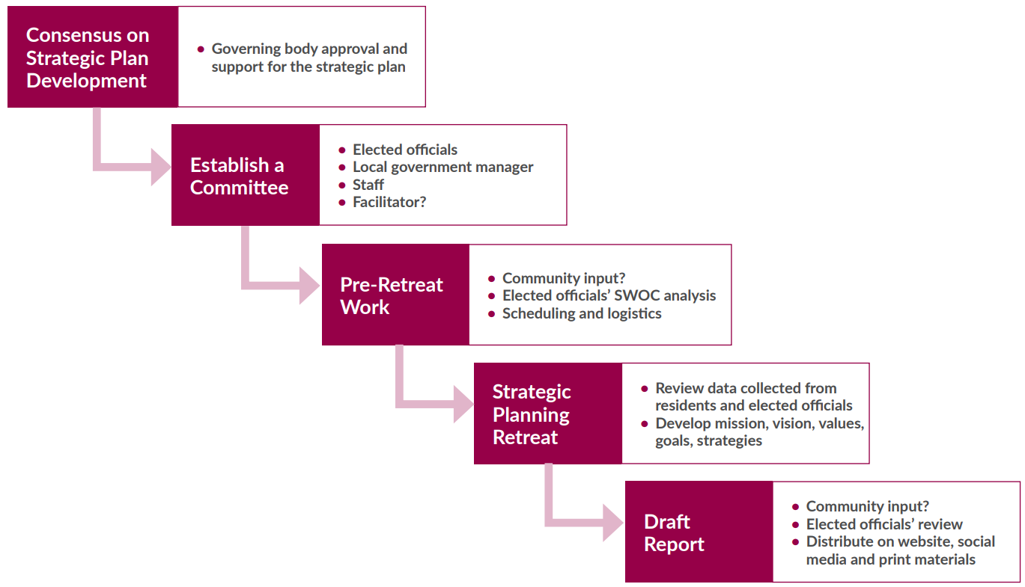
The Strategic Planning Process

Slide 25
Develop Consensus on Strategic Plan Development
The BOCC is essential to lead the charge. It will not be a valuable product if they are not deeply involved in the process. Remember, a strategic plan:
Serves as a communication device for elected officials, staff, and the public.
Helps prioritize organizational work and the limited financial resources available.
Serves as a decision-making tool for controversial issues.
Creates clear guidance on the goals of the governing body to staff and can serve as an accountability tool for their performance.

Slide 26
Establish a Committee
Key members include:
BOCC
Department heads
Local city leaders
School district leaders
Other key community leaders
Determine if you want a facilitator

Slide 27
Gather info for Retreat
Employee survey
BOCC survey
Community survey or town-hall type meetings
SWOT analysis

Slide 28
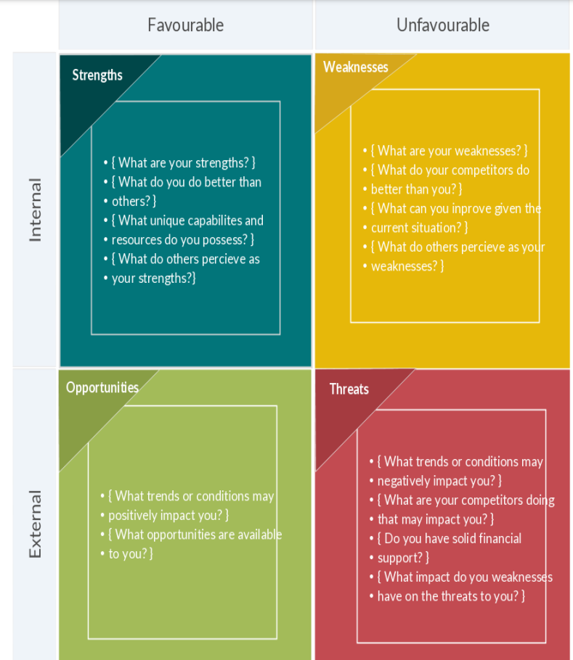
Examples
Strengths
Environmental Resources
Rural Charm
Scenic vistas
Local agriculture
Community involvement
High income
Weaknesses
Inadequate growth management
Lack of transportation options
Traffic Safety
Access to Nature
Undiversified Economic Base

Slide 29
Examples
Opportunities
Broadband internet
Local economic development
Agri-businesses
Threats
Aging population
Shrinking population
Lack of development

Slide 30
Hold Retreat
The purpose of the retreat is to develop the strategic plan and the deliverable at the end of the meeting should be a draft that includes a mission, vision, values statement or values, goals, and strategies to achieve the goals.
You should have an agenda with a schedule

Slide 32
Produce Report
Produce a simple document showing the overall goals of the BOCC

Slide 33
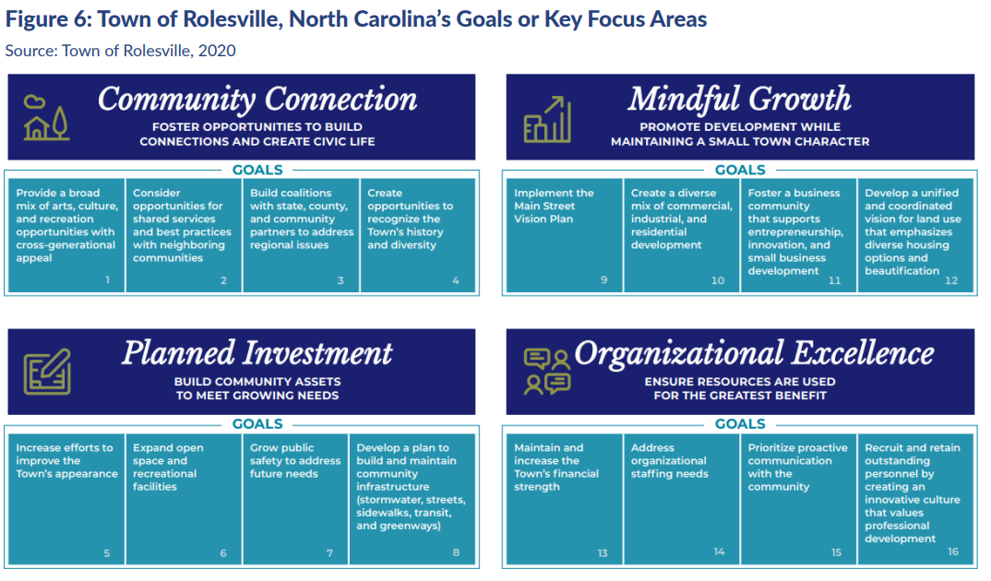

Slide 34
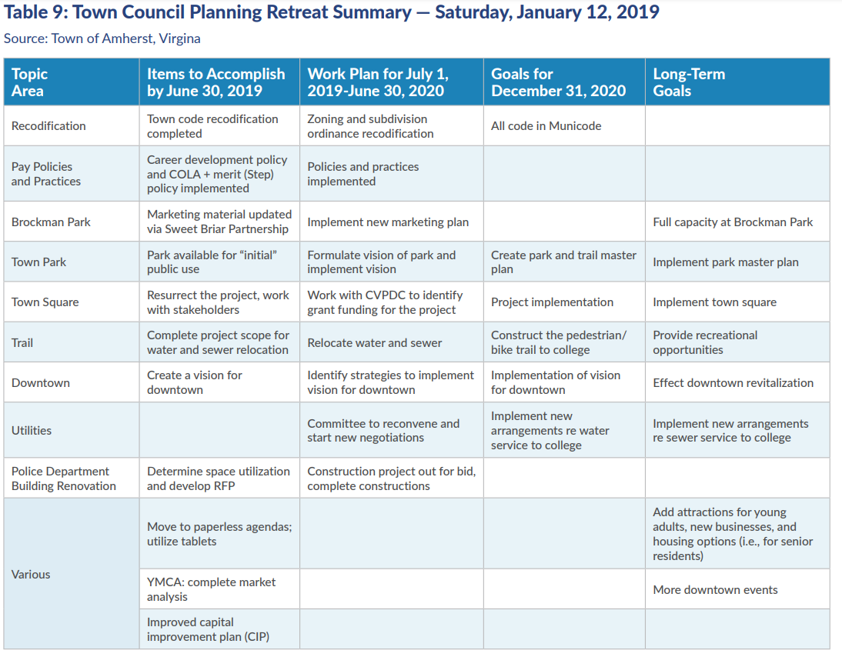

Slide 35
Link to the budget
Before discussion specific budget items, review your strategic plan and prioritize items and specific requests that align with your strategic plan
You may need to not do other things, or not do the at the same level, to accomplish some goals.
Doing this over 5-10 years can make a huge difference in the direction of your county.

Slide 36
Butler County Example Documents
Open documents separately

Slide 37
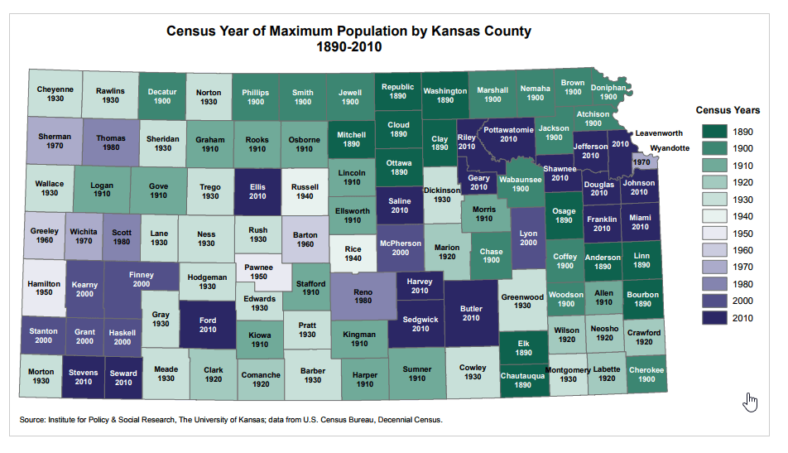

Slide 40
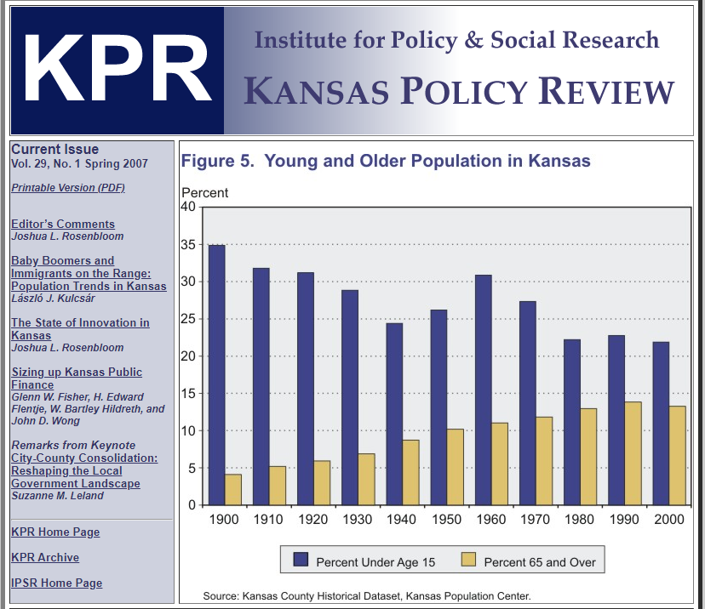

Slide 41
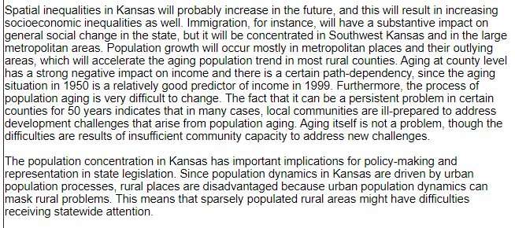
source: https://ipsr.ku.edu/publicat/kpr/kprV29N1/kprV29N1A1.shtml

Slide 42
References
https://icma.org/sites/default/files/2022-09/Strategic%20Planning%20in%20Small%20Communities%20Final_1.pdf
http://www.communitiescommittee.org/pdfs/strategic.pdf
https://www.bucoks.com/Archive.aspx?AMID=36

